Slide 1
Graph-Based Human Mobility Prediction
With Weighted Cell-Transition Graphs And Node2Vec
Embeddings
Davide Lugli
LM Ingegneria Informatica / A.a. 2023-24
Graph Analytics

Slide 2

Problem
The task at hand comes from the SIGSPATIAL CUP 2025 challenge and is about mobility prediction:
4 cities (A–D), each a 200×200 grid
1 cell = 500×500 m
Data: user positions every 30 minutes for 75 days
Goal: predict masked positions (x=y=999) for days 61–75 (3000 users per city)

Slide 3
Graph-Based Approach
The reasons for using a graph-based approach to solve this task can be summarized as:
Mobility is basically transitions between cells
Edges can store direction and how often it happens
Helps highlight corridors / hubs / communities
Makes it possible to learn cell embeddings from movement structure

Slide 4
Pipeline
The pipeline is composed as follows:
Build a weighted directed cell-transition graph
Train Node2Vec embeddings with PecanPy
Create user-context prototypes in embedding space
Predict by ranking candidates with cosine similarity (+ fallbacks)

Slide 5
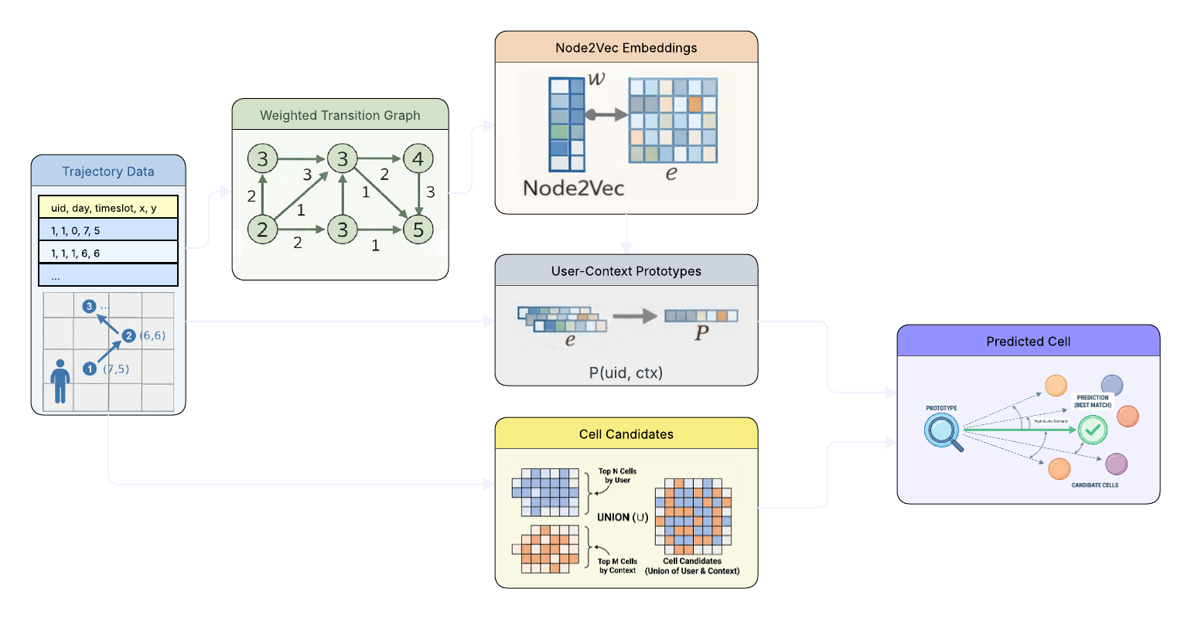
Pipeline

Slide 6
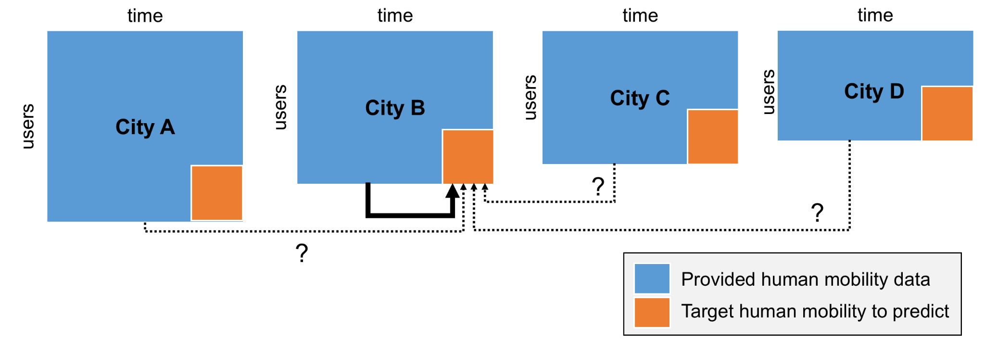
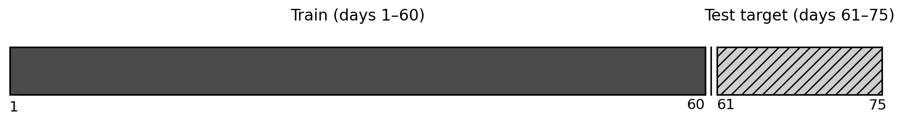
Dataset and Preprocessing
Split per city:
Train: days 1–60
Test: days 61–75
Sort trajectories by (uid, d, t)
Fill missing time bins with forward-fill (last known position)
Masked rows are tracked and excluded from evaluation

Slide 7
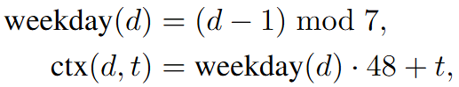
Encoding Space + Time
Convert each (x,y) into a cell_id in
[0, 39999]
Define a weekly context:
Weekday from day index
Context = weekday + time slot
Context range: 0–335 (7 days × 48 slots)

Slide 8
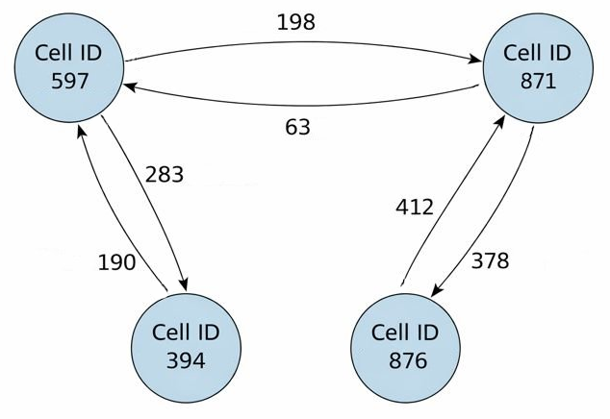
Graph Definition
Nodes: grid cells observed in training
Edges: consecutive movements u → v
Weight: how many times the transition appears
Remove self-loops (u = v) to focus on movement

Slide 9
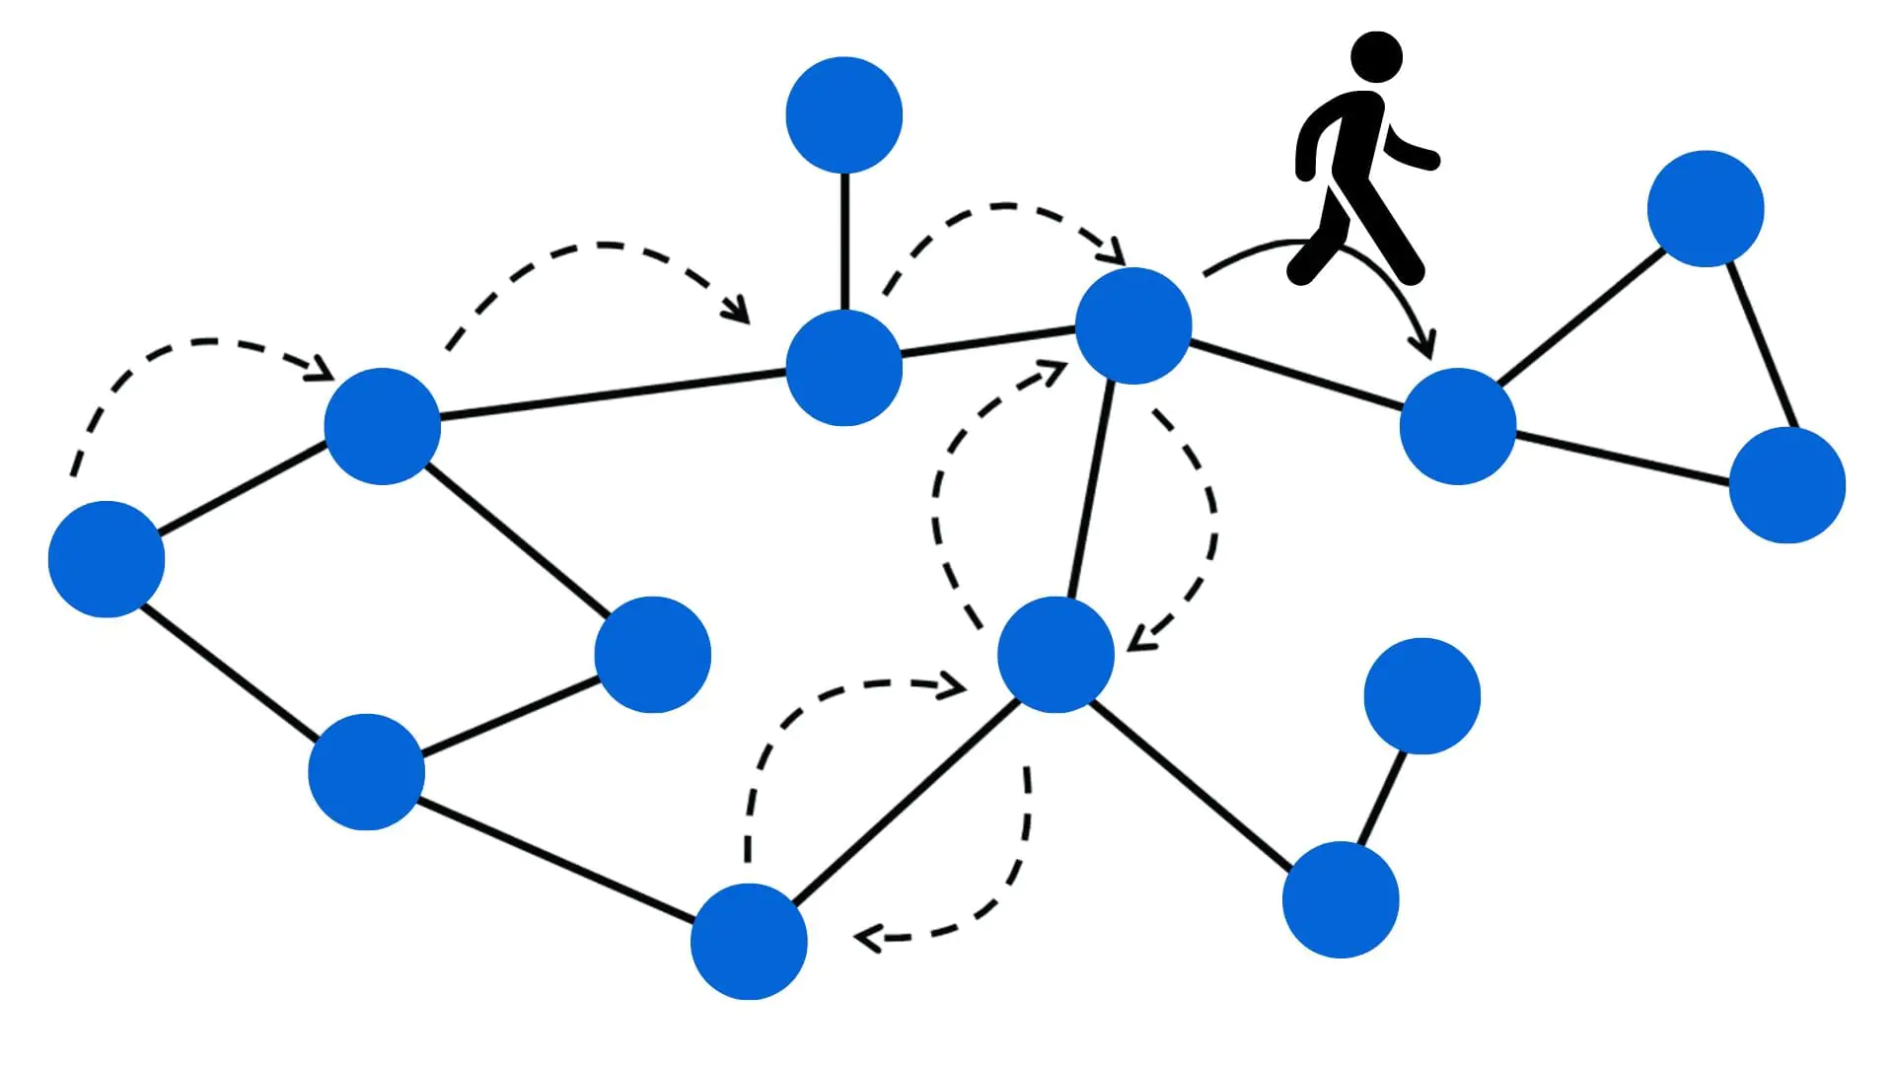
Node2Vec Embeddings
Random walks on the graph → sequences like “sentences”
Train skip-gram so frequently co-visited cells get similar vectors
Weighted edges are sampled more often → strong transitions matter more
PecanPy SparseOTF for large sparse graphs
Notes:
Skip-gram is the simple training trick behind Word2Vec: you take a sequence and teach a model to predict which items appear near a given item

Slide 10
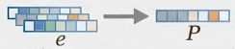
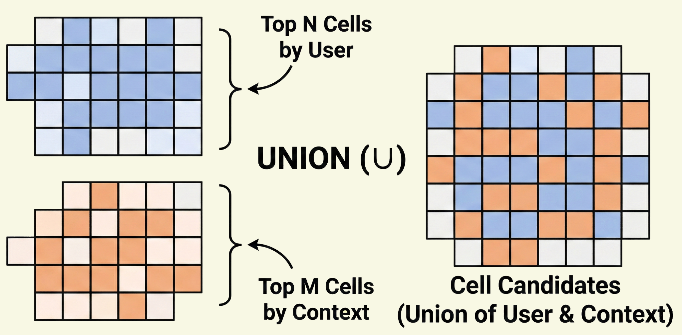
Prototypes + Candidate Priors
Prototype for each (uid, ctx):
Average embeddings of user locations in that context
Candidate set (don’t score all 40k cells):
Top-N frequent cells for the user
Top-M frequent cells for the context
Add previous predicted cell to allow “stay”

Slide 11
Scoring + Fallbacks
Rank candidates with cosine similarity (candidate vs prototype)
Add a soft distance penalty from previous cell:
Discourages unrealistic jumps
If prototype/candidates missing:
Most frequent user cell
Most popular context cell
Any valid cell

Slide 12
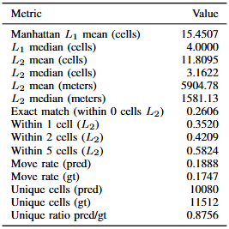
Evaluation Results
Exact match ≈ 0.26
Median errors are much smaller than mean → a small number of cases have really large errors
Predicted unique cells are less than ground truth → missing some moves
Likely causes:
true cell missing from candidate set
similarity ties + popularity push small unnecessary moves
Notes:
A small number of cases have really large errors, and those rare big mistakes don’t die off quickly = definition of heavy-tail

Slide 13
Future Works
Add a stronger transition-based prior from the previous cell (top-K outgoing neighbors).
Add an explicit inertia / stay bias to reduce restless switching.
Tune Node2Vec hyperparameters (p, q, walk length, window) and re-evaluate.

Slide 14

Thanks!
Do you have any questions?
Davide Lugli
269692@studenti.unimore.it

